Slide 1
Programarea aplicatiilor in NodeJS
Curs 9

Slide 2
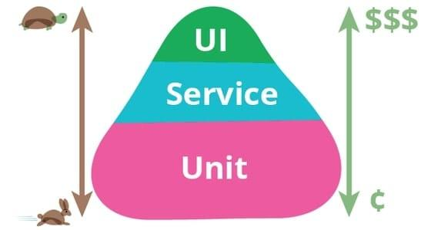
Functional testing
Types of functional tests:
Manual testing
Automated testing
Unit testing (tests units of code)
Integration testing (tests integration between components)
E2E testing (tests real flows from UI/client perspective)

Slide 3
Automated testing
Feature | Unit testing | Integration testing | E2E testing
Focus | Individual units of code (functions, services) | Interactions between components | Entire user experience flow
Speed | Fastest | Slower than unit | Slowest
Tooling | Jest, Mocha | Jest, Supertest | Cypress, Selenium
Cost | Low | Moderate | High
Maintenance | Low | Moderate | High

Slide 4
Further reading
https://qase.io/blog/test-pyramid
https://www.testim.io/blog/jest-testing-a-helpful-introductory-tutorial/

